Slide 1
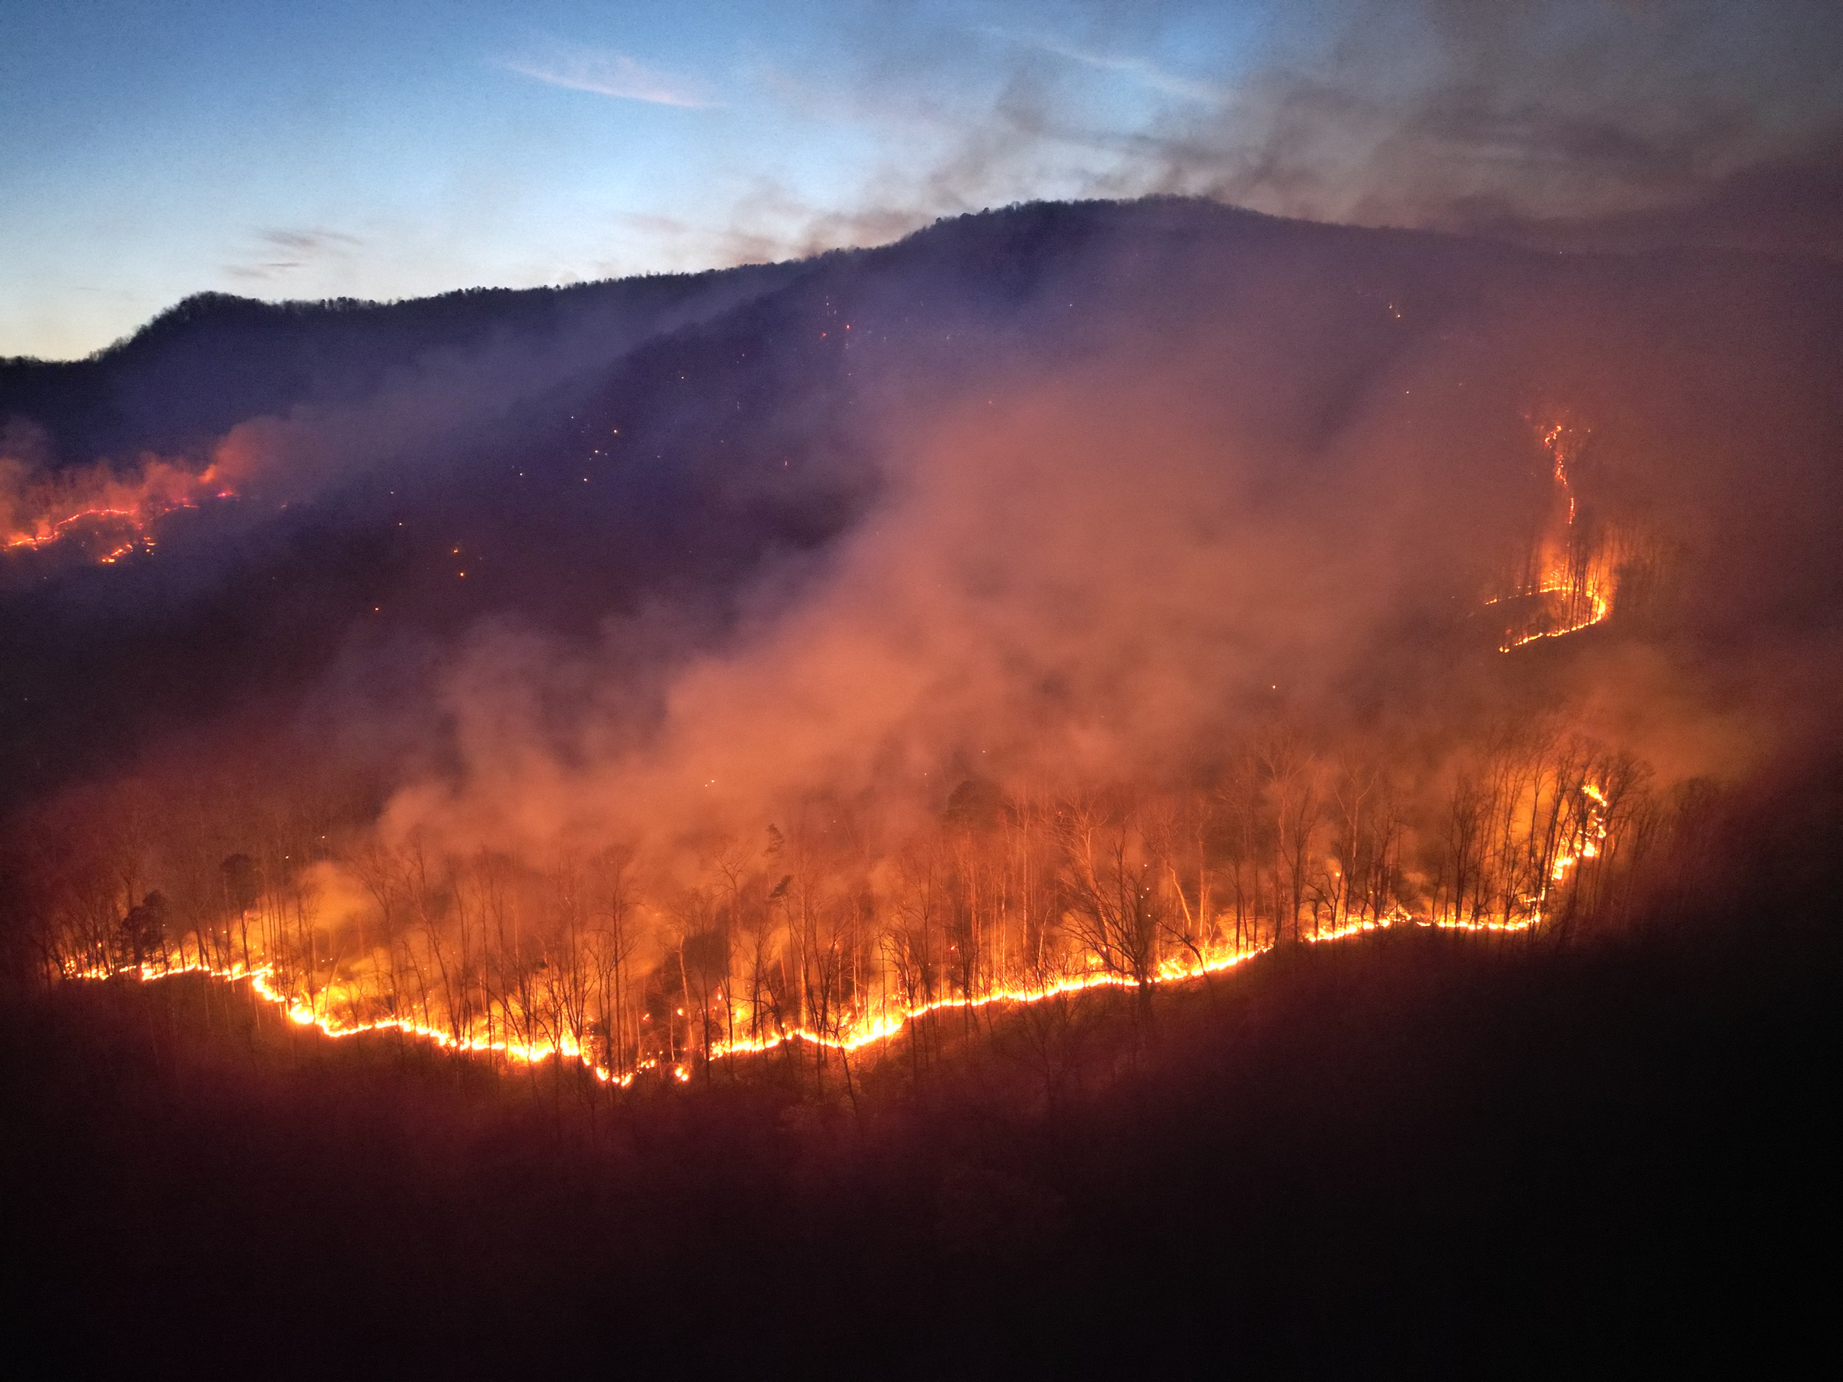


POLK COUNTY EMERGENCY MANAGEMENT
BLACK COVE COMPLEX FIRE
Prepared By:
Bobby Arledge
Polk County Emergency Management Director
www.PolkNC.gov/FireUpdates

Slide 2

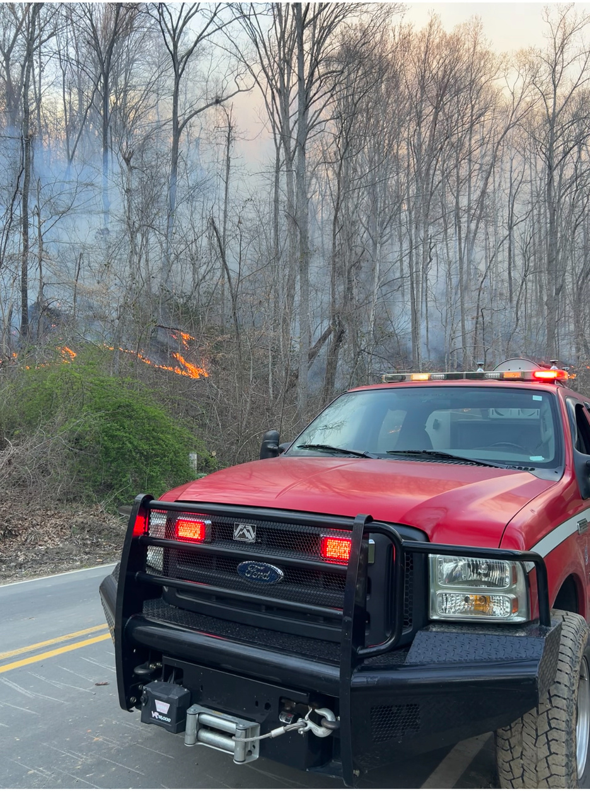

BLACK COVE COMPLEX FIRE
Timeline
3/19
3/19
3/20
2:12 pm
8:42 pm
5:38 pm
Black Cove
Fire
Deep Woods
Fire
Fish Hook
Fire

Slide 3
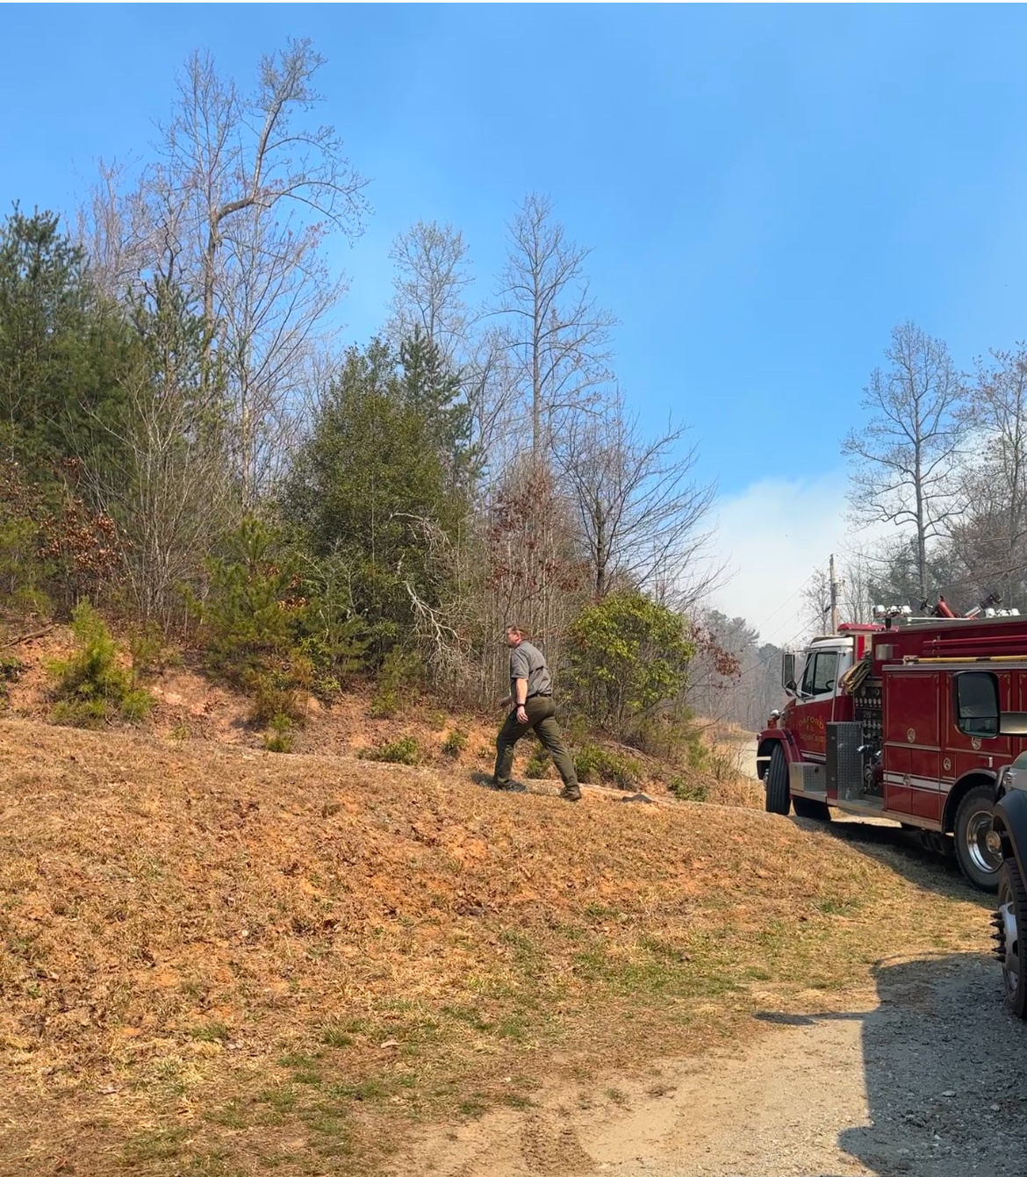


BLACK COVE COMPLEX FIRE
Initial Findings
Vegetative debris from Hurricane Helene
Unified Command/ICP - Green River Cove -Lack of Communication NCFS/Local FD
Communication- Evacuation areas, text for WEA, door to door evacuation
Ready, Set, Go Evacuation Process
Polk County IMT
Resource Tracking
Field Communications
Polk County Sheriff Tim Wright
conducting door to door evacuations.
Best Practices
State of Emergency/Burn Bans
Interactive Evacuation Map
County PIO/GIS Tech
Collaboration of firefighting efforts
Stakeholders Briefings

Slide 4

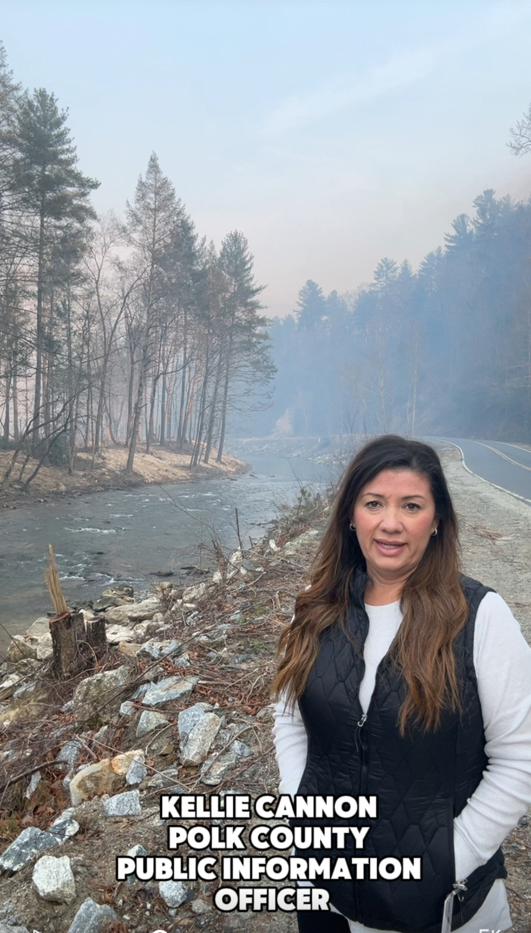

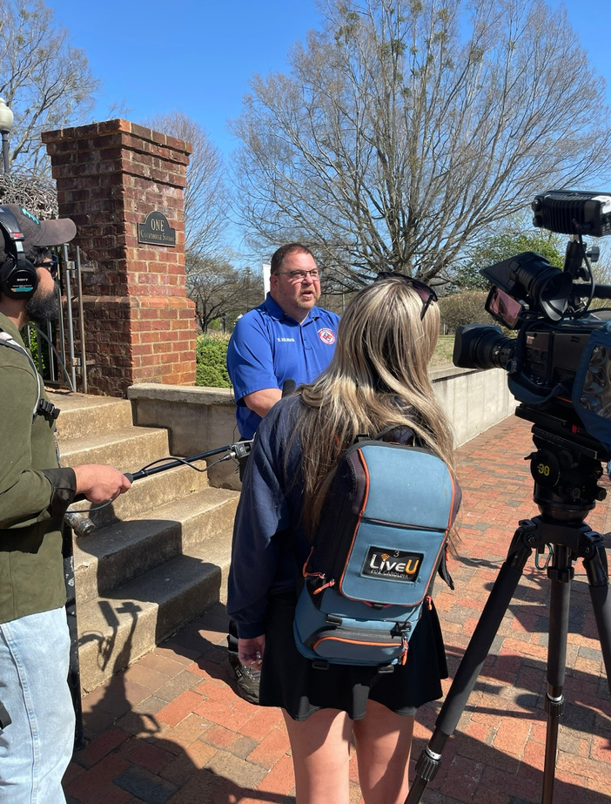
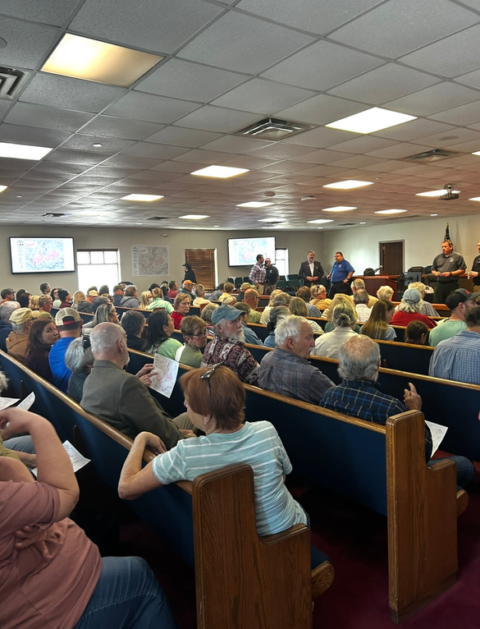
BLACK COVE COMPLEX FIRE
Community Engagement
Wireless Emergency Alerts
Media Interviews
Social Media Updates
Dedicated Website for Fire Updates
Community Townhalls

Slide 5
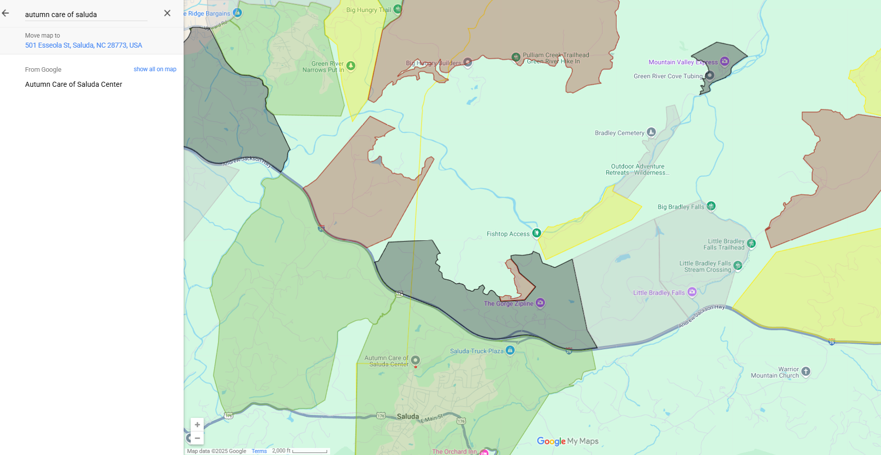
Interactive Map
BLACK COVE COMPLEX FIRE
Importance of integrating County level GIS into Operations

Slide 6
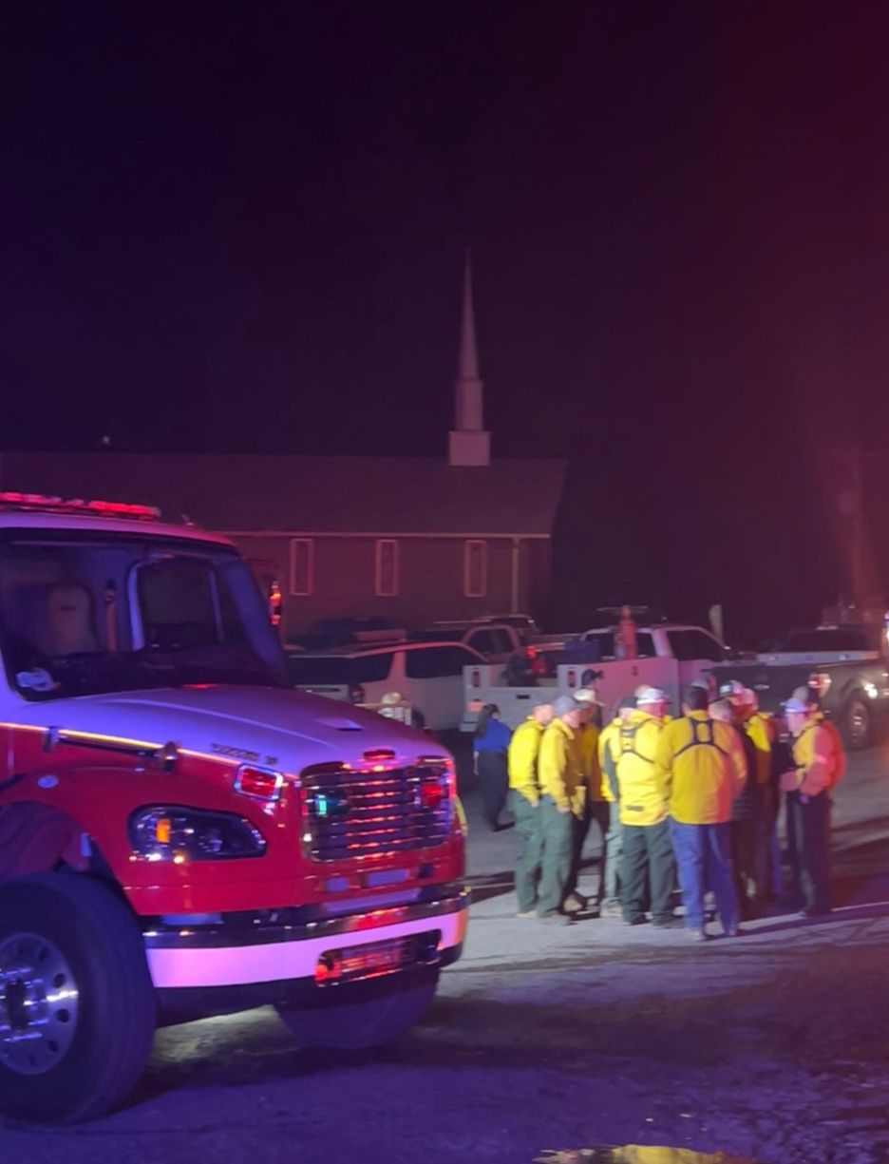
BLACK COVE COMPLEX FIRE
7,670 Total Acres
3,502
3,969
199
Cause:
Powerline
Cause:
Under
Investigation
Cause:
Powerline
Black Cove
Fire
Deep Woods
Fire
Fish Hook
Fire

