Slide 1



The Latest on the MJO
Carl Schreck¹
Dave Margolin²
Jay Cordeira^{2,3}
1
3
2
MJO Background
MultiVariate PNA (MVP)
Tale of Two MJOs

Slide 2
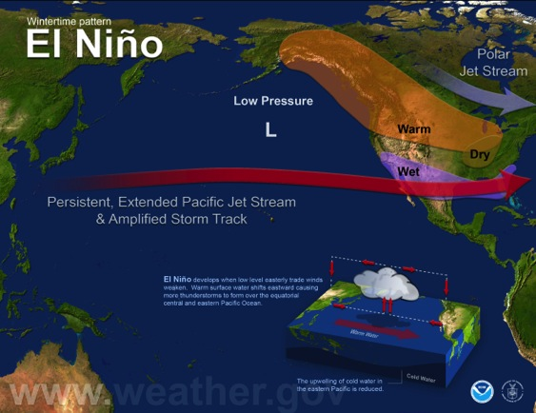
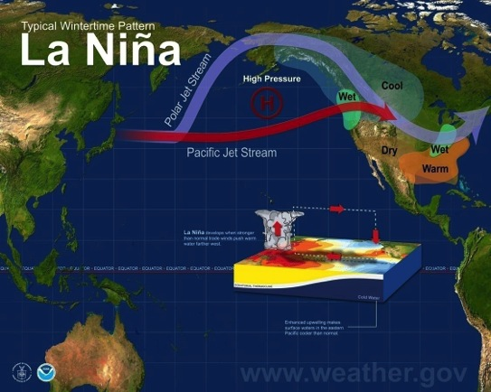
Consider El Niño/La Niña
Ocean Anomalies
Convection
Divergent Circulations
Mid-latitude Weather Patterns
MJO Background
MultiVariate PNA (MVP)
Tale of Two MJOs

Slide 3
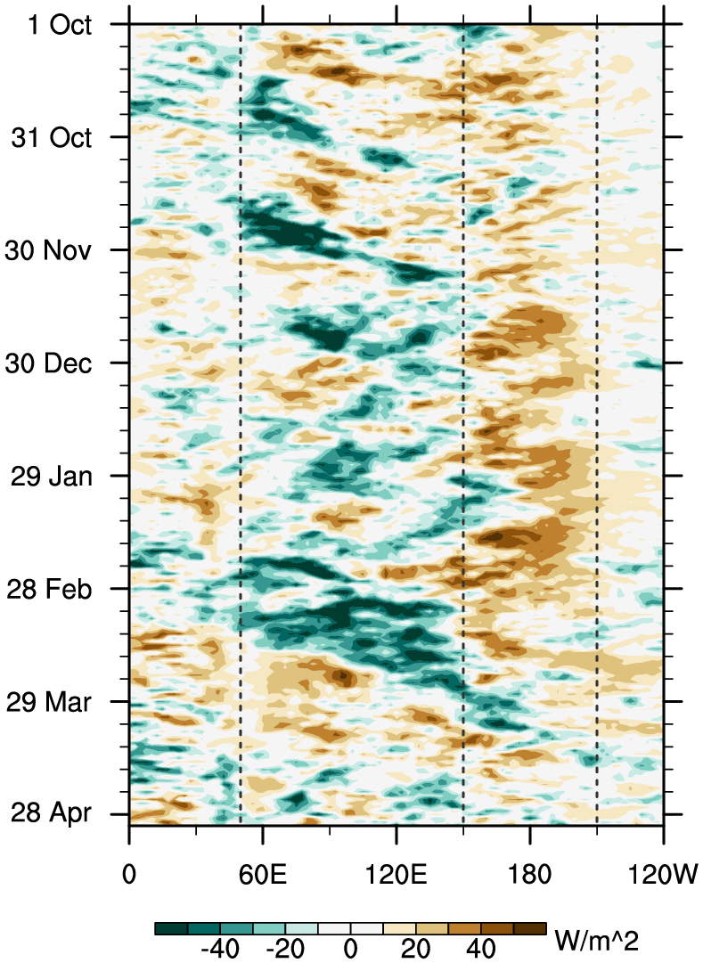
Tropical Variability
ENSO creates longitudes of enhanced or suppressed convection
Madden–Julian Oscillation (MJO) and tropical waves modulate and move those patterns
Those movements change the temperature response over the U.S.
Kelvin
ER
MJO
MJO Background
MultiVariate PNA (MVP)
Tale of Two MJOs

Slide 4
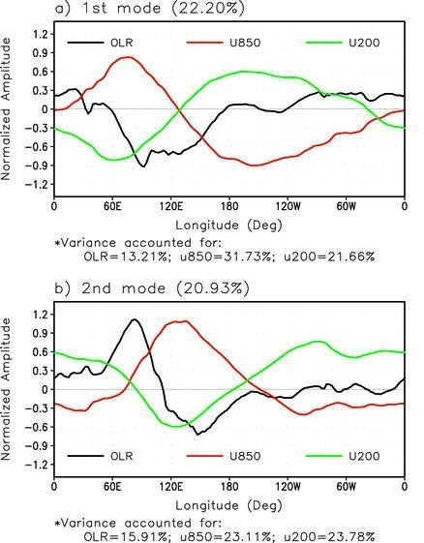
Real-time Multivariate MJO (RMM) Index
Wheeler and Hendon (2004)
Based on extended EOFs:
  Outgoing longwave radiation (OLR)
  850 hPa zonal wind
  200 hPa zonal wind
Averaged 15°S–15°N
MJO Background
MultiVariate PNA (MVP)
Tale of Two MJOs

Slide 5
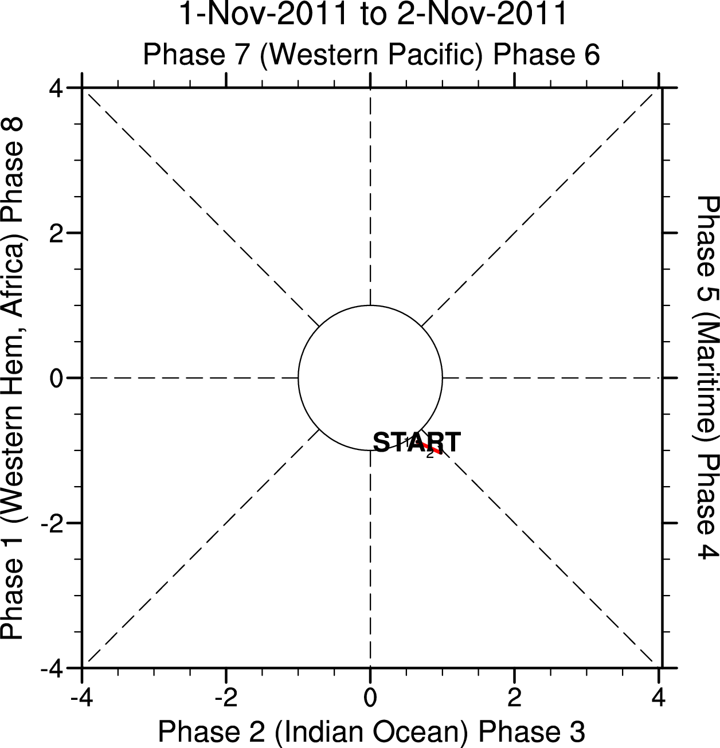
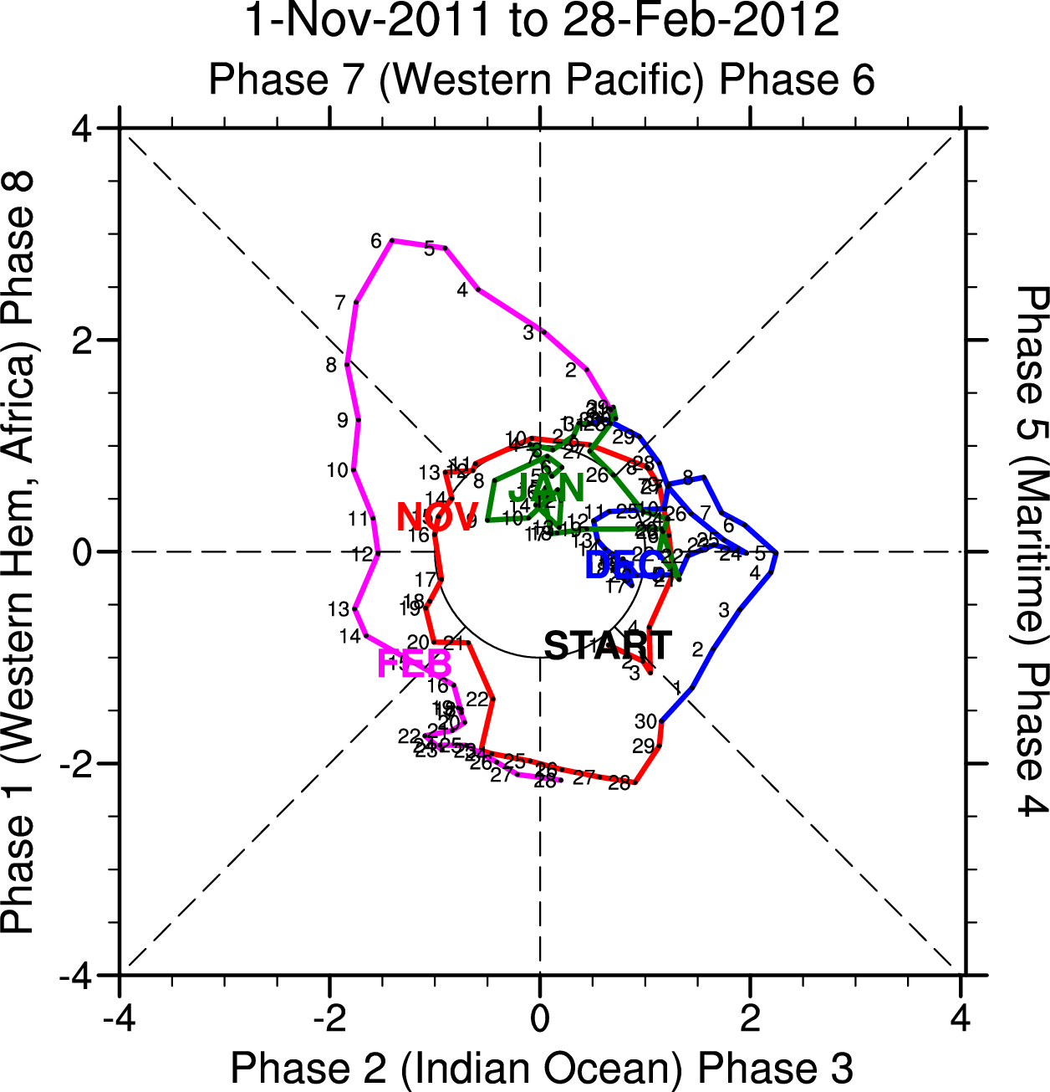
RMM Phase Space
Illustrates phase and amplitude
Moves counter-clockwise at ≈6 days per phase
Used with observations, forecasts, and climate models
MJO Background
MultiVariate PNA (MVP)
Tale of Two MJOs

Slide 6
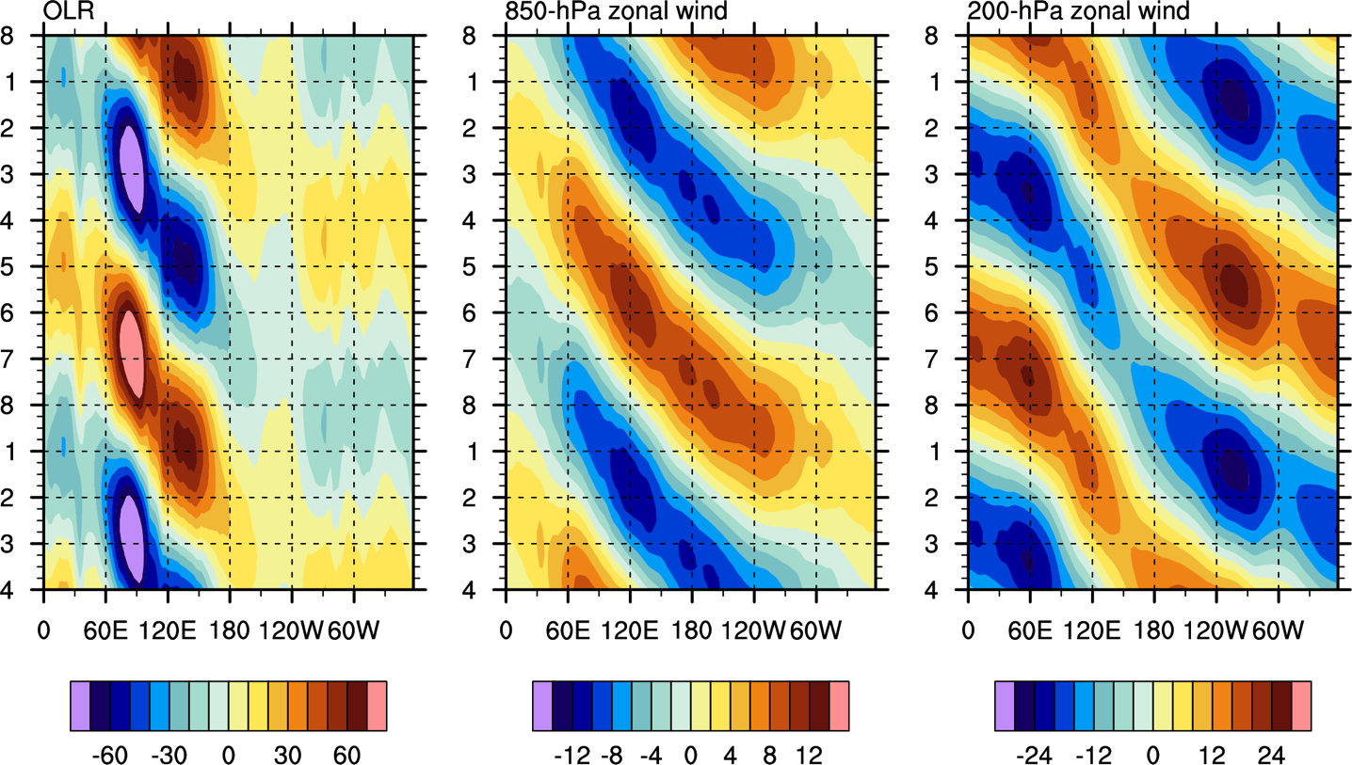
RMM Composite
MJO Background
MultiVariate PNA (MVP)
Tale of Two MJOs

Slide 7
Contribution to RMM Amplitude
RMM is dominated by winds
  Esp. 200-hPa zonal wind
Average for 2002–2012 Data courtesy of M. Wheeler
MJO Background
MultiVariate PNA (MVP)
Tale of Two MJOs

Slide 8
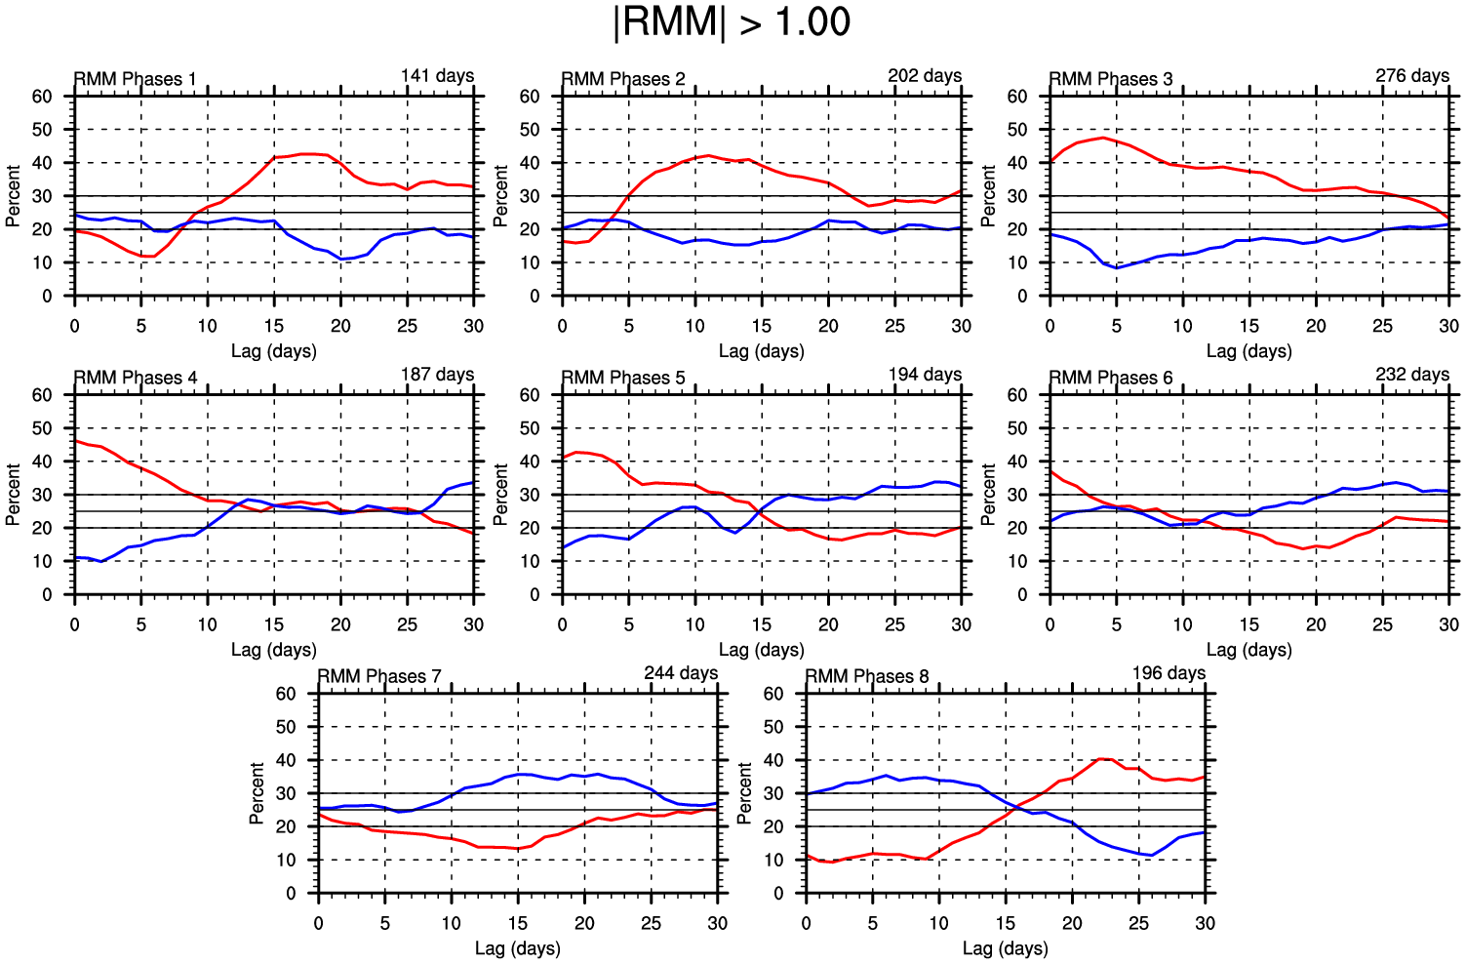
MJO and MidWest-East
MJO Background
MultiVariate PNA (MVP)
Tale of Two MJOs

Slide 9
Key Problem
Can we distinguish MJO events that affect U.S. Temperatures from those that don’t?
MJO Background
MultiVariate PNA (MVP)
Tale of Two MJOs

Slide 10
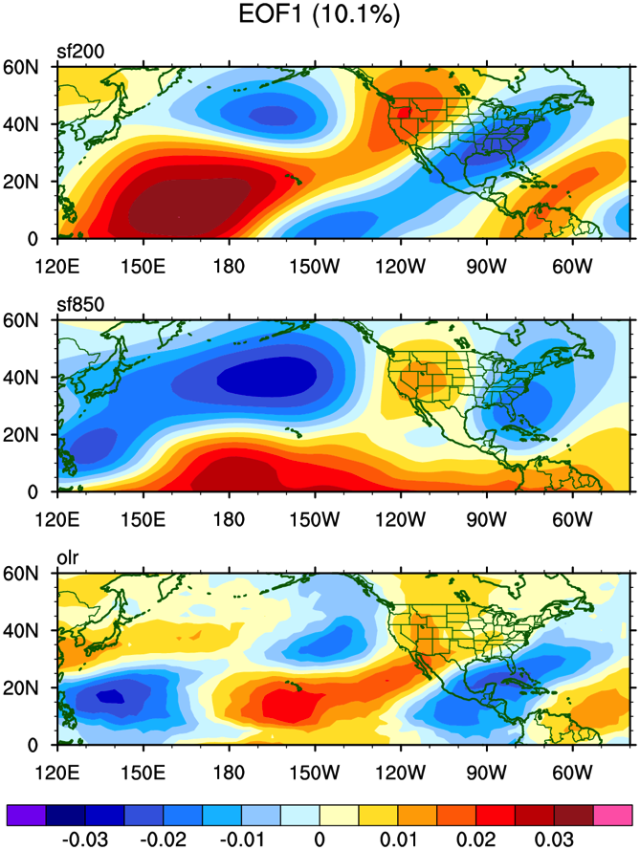
MultiVariate PNA (MVP) Index
200-hPa Wave train over the Pacific and North America
Anomalous 850-hPa zonal winds near Hawaii
Convective anomaly south of Hawaii
Correlation of 0.57 with PNA
MJO Background
MultiVariate PNA (MVP)
Tale of Two MJOs

Slide 11
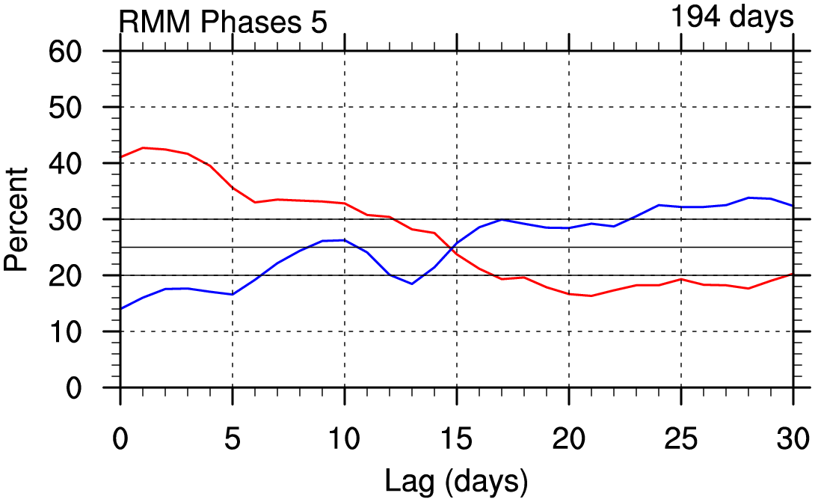
Heat in Phase 5
MJO Background
MultiVariate PNA (MVP)
Tale of Two MJOs

Slide 12
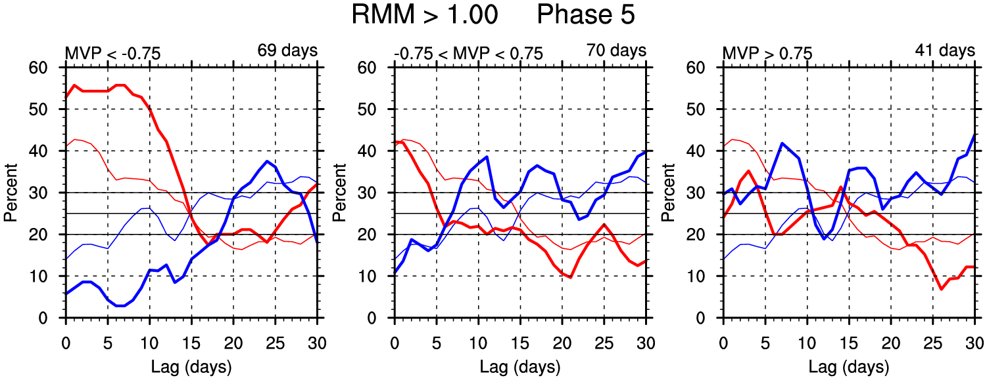
MVP in Phase 5
−
0
+
RMM and MVP
Heat only occurs with Negative MVP
No signal when MVP is weak or Positive
  Good distribution of days between the three categories
RMM Only
MJO Background
MultiVariate PNA (MVP)
Tale of Two MJOs

Slide 13
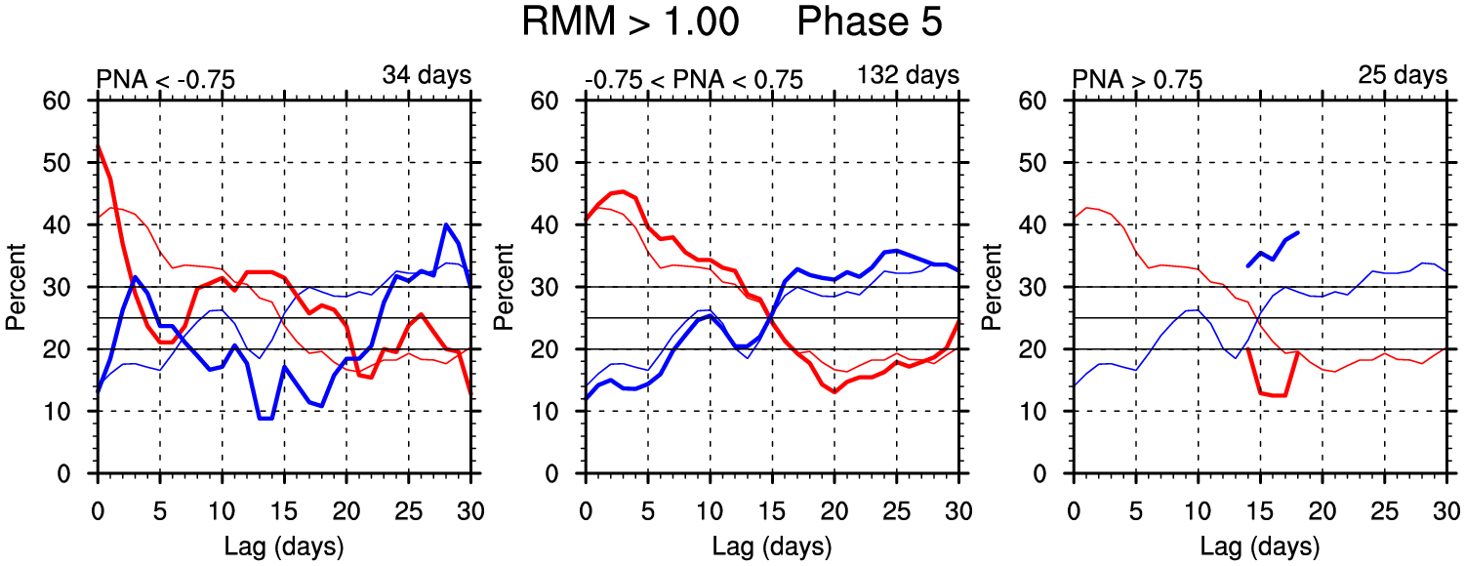
PNA in Phase 5
−
0
+
RMM and PNA
Warm signal is primarily when PNA is neutral
  Accounts for the most days
  Not enough days for Positive PNA
RMM Only
MJO Background
MultiVariate PNA (MVP)
Tale of Two MJOs

Slide 14
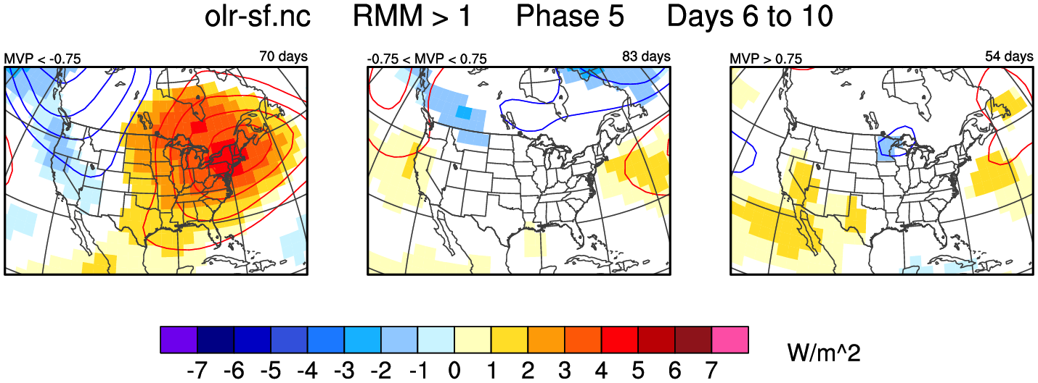
North America with MVP
−
0
+
850 Temperature anomalies are shaded. 500-hPa Height anomalies are contoured.
MJO Background
MultiVariate PNA (MVP)
Tale of Two MJOs

Slide 15
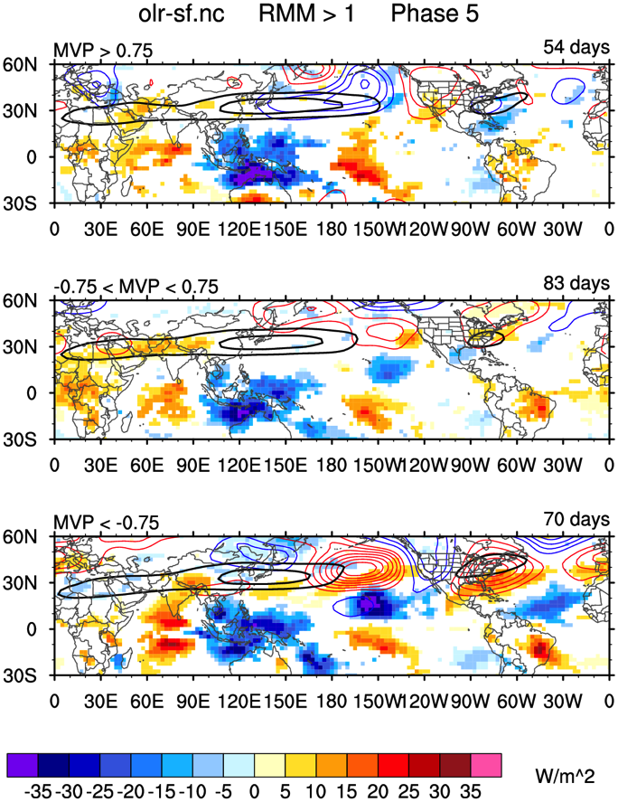
Global Patterns
Elongated Jet in positive MVP
Enhanced convection near Hawaii leads to ridging in negative MVP
+
0
−
OLR anomalies are shaded.
500-hPa Height Anomalies are contoured.
Black contours show Total 200-hPa Zonal Wind.
MJO Background
MultiVariate PNA (MVP)
Tale of Two MJOs

Slide 16
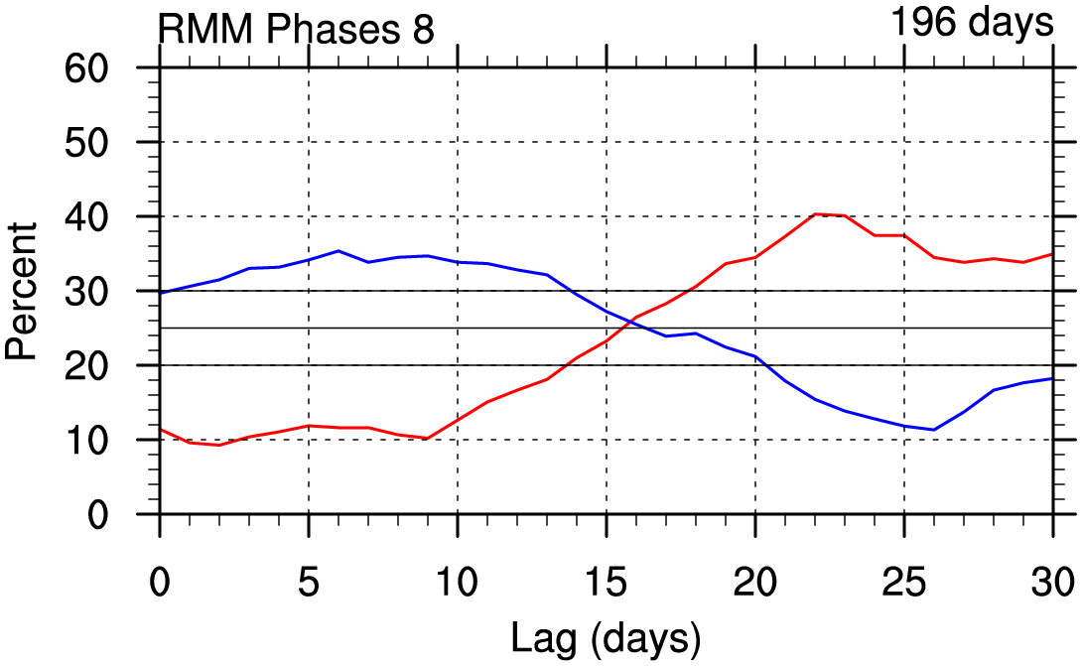
Cold in Phase 8
MJO Background
MultiVariate PNA (MVP)
Tale of Two MJOs

Slide 17
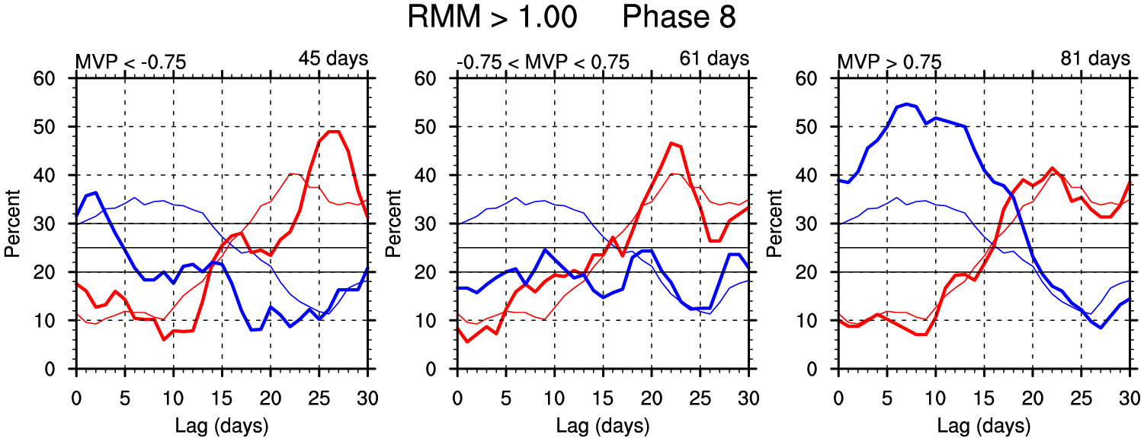
MVP in Phase 8
−
0
+
RMM and MVP
Cold only occurs with Positive MVP
No signal when MVP is weak or negative
RMM Only
MJO Background
MultiVariate PNA (MVP)
Tale of Two MJOs

Slide 18
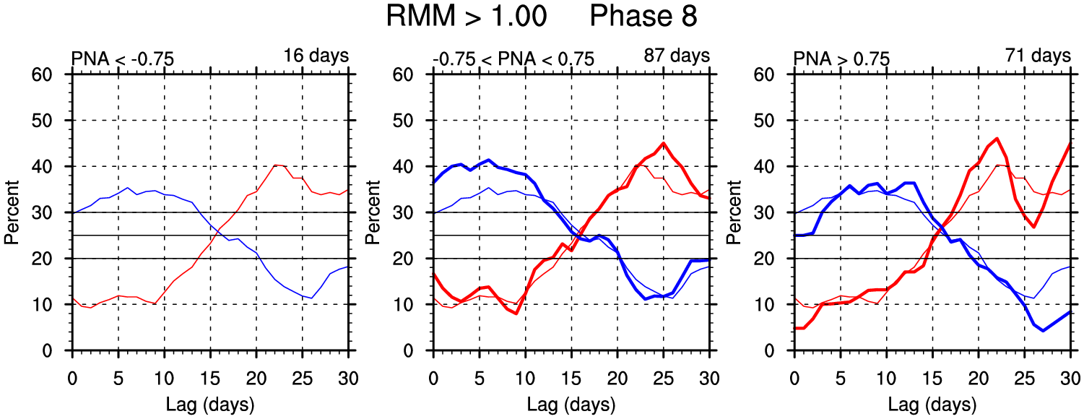
PNA in Phase 8
−
0
+
Cold occurs when PNA is Positive or Neutral
Not enough days to see a signal for Negative PNA
RMM and PNA
RMM Only
MJO Background
MultiVariate PNA (MVP)
Tale of Two MJOs

Slide 19
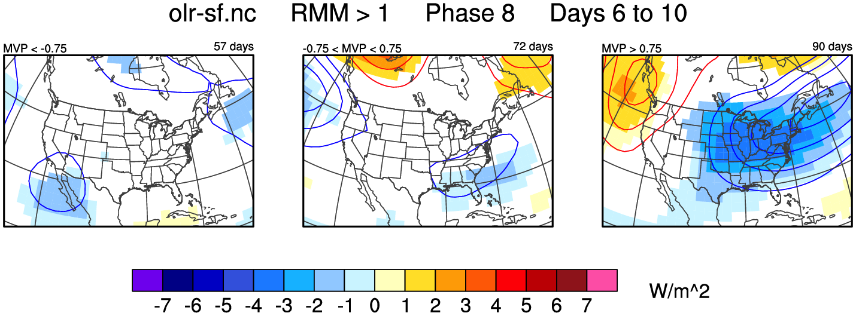
North America with MVP
−
0
+
850 Temperature anomalies are shaded. 500-hPa Height anomalies are contoured.
MJO Background
MultiVariate PNA (MVP)
Tale of Two MJOs

Slide 20
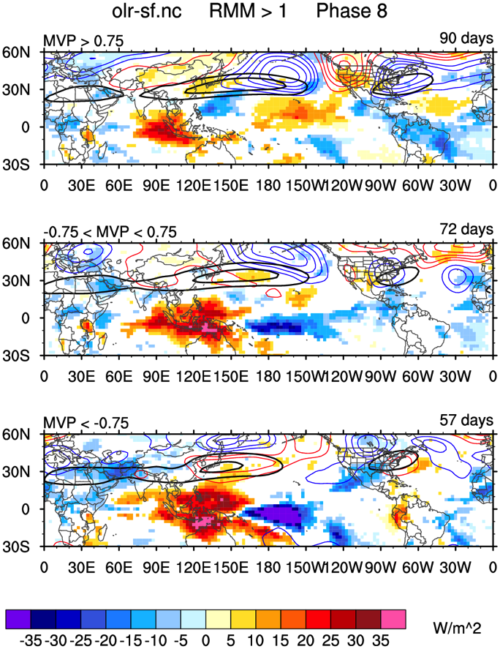
Global Patterns
Suppressed convection and troughing in positive MVP
Unusual convective pattern near Maritime Continent
+
0
−
OLR anomalies are shaded.
500-hPa Height Anomalies are contoured.
Black contours show Total 200-hPa Zonal Wind.
MJO Background
MultiVariate PNA (MVP)
Tale of Two MJOs

Slide 21
Tale of Two MJOs
Mar-2012 and Dec-2000 both had active MJOs
United States temperature anomalies were very different
MVP identifies the stronger warm signal in Mar-2012
MJO Background
MultiVariate PNA (MVP)
Tale of Two MJOs

Slide 22
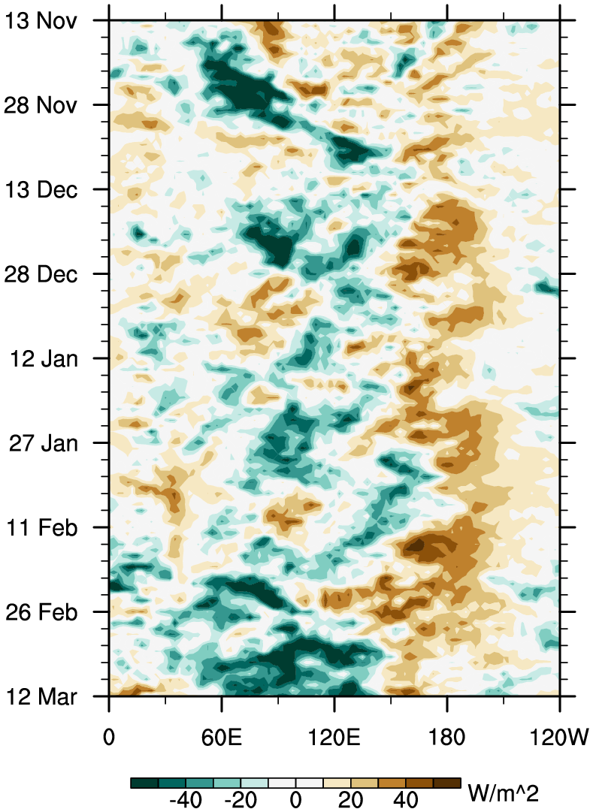
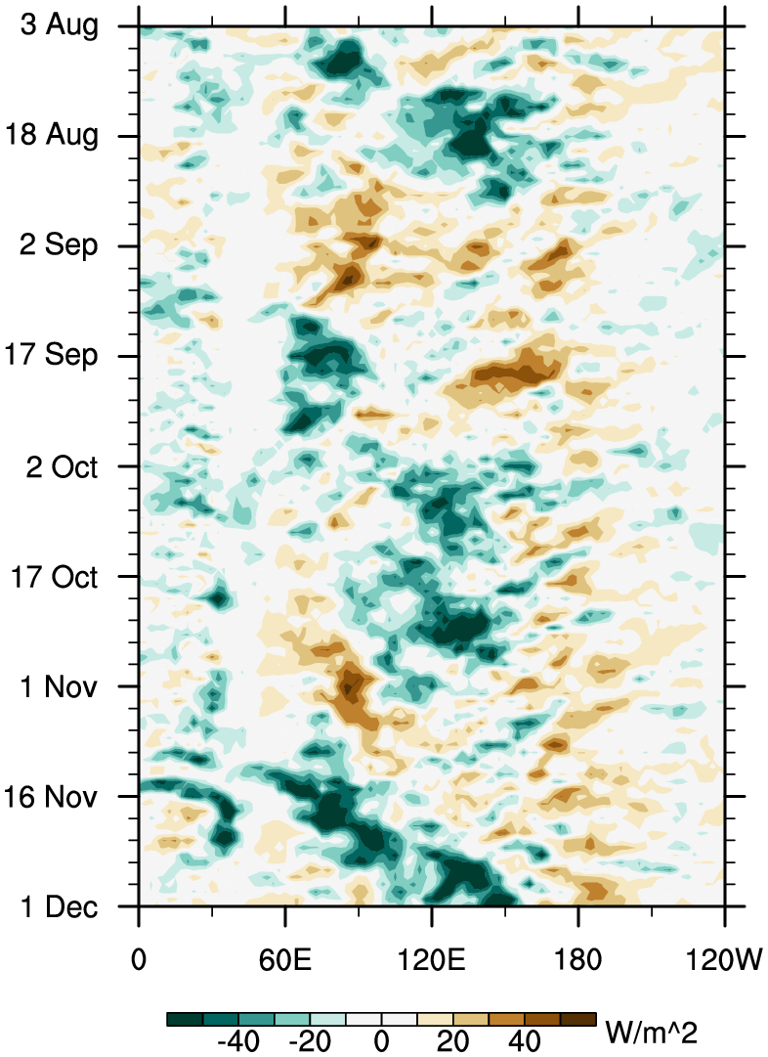
OLR Hovmöller
March 2012
December 2000
MJO Background
MultiVariate PNA (MVP)
Tale of Two MJOs

Slide 23
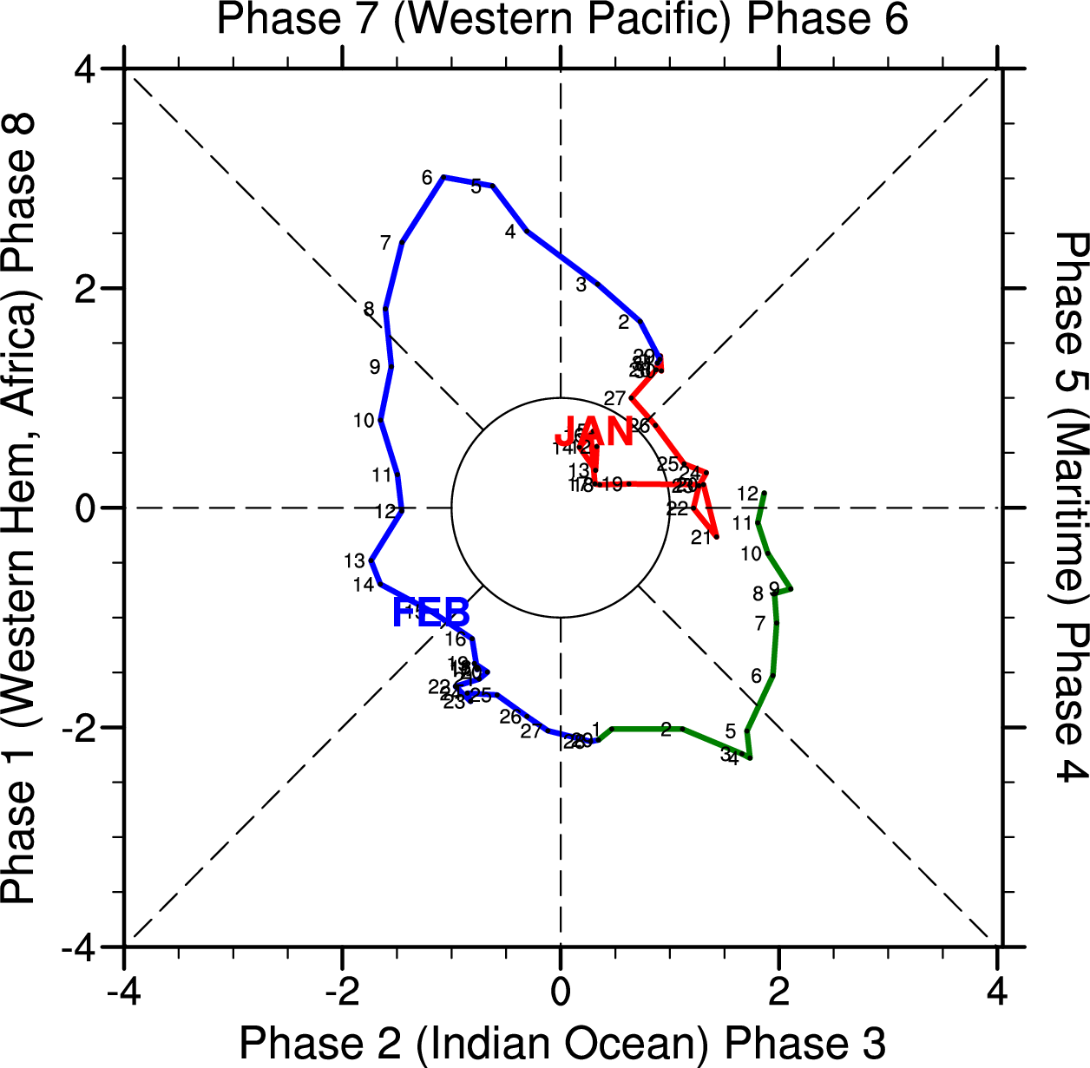
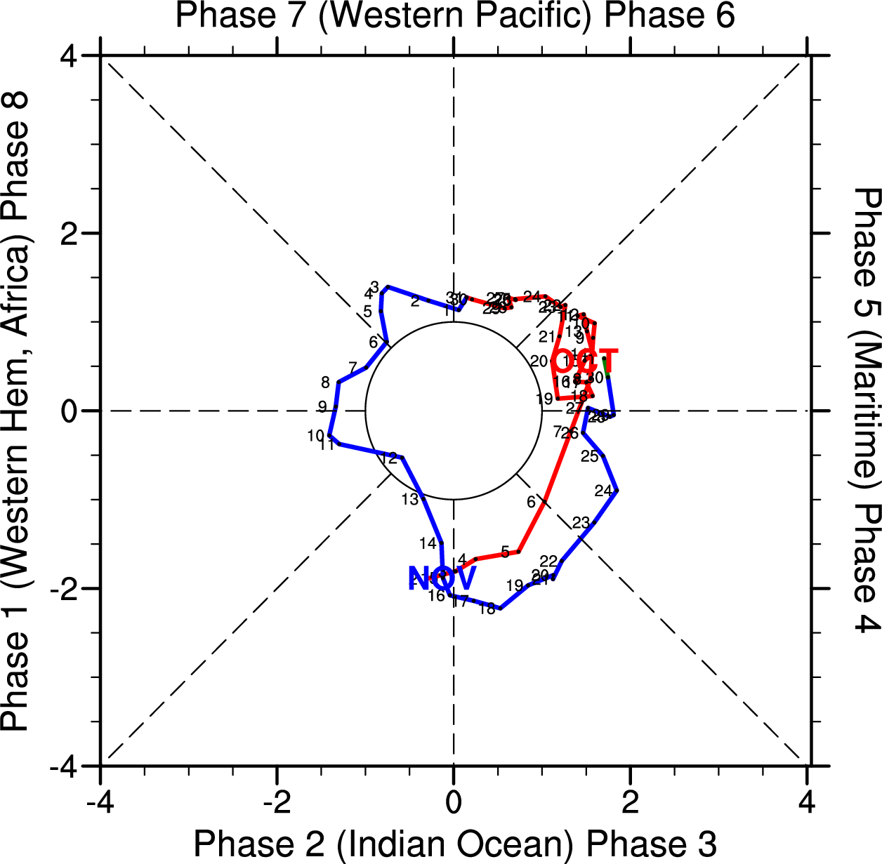
Wheeler–Hendon
March 2012
December 2000
MJO Background
MultiVariate PNA (MVP)
Tale of Two MJOs

Slide 24
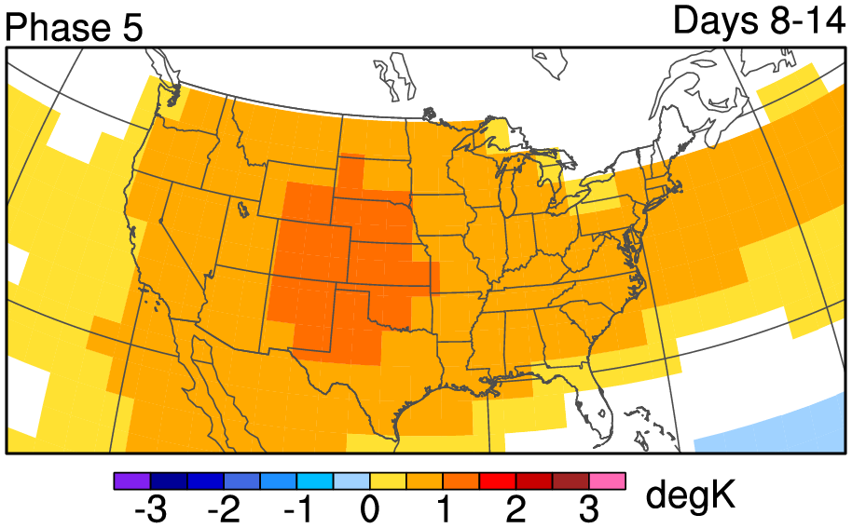
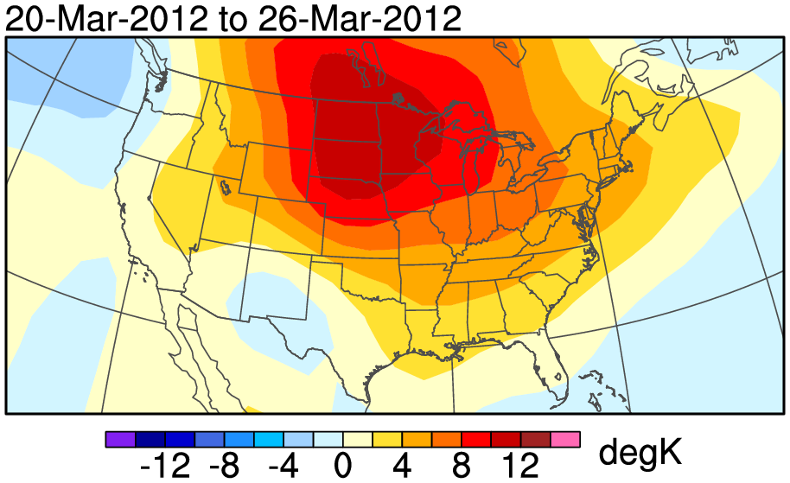
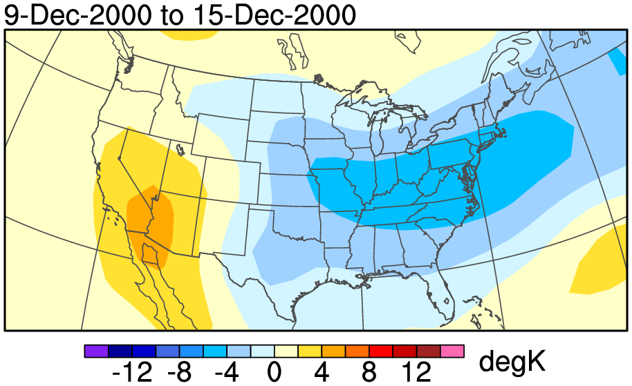
Week-2 based on RMM only
March 2012
December 2000
“Forecasted”
Observed
MJO Background
MultiVariate PNA (MVP)
Tale of Two MJOs

Slide 25
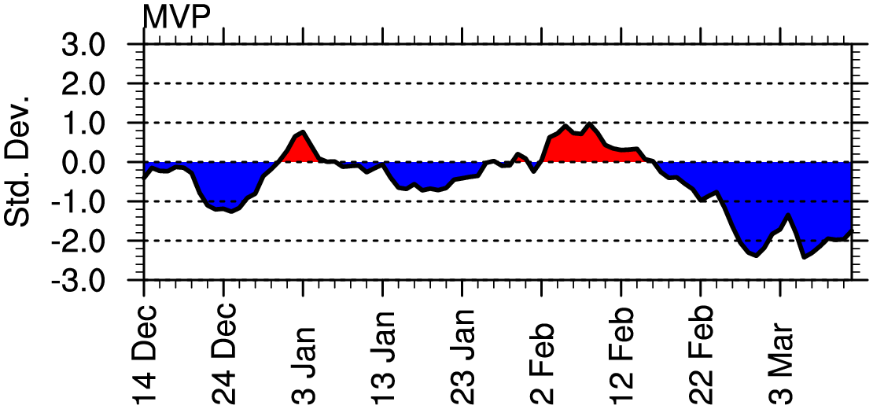
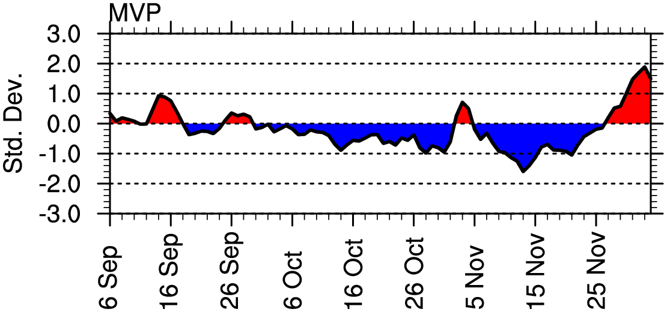
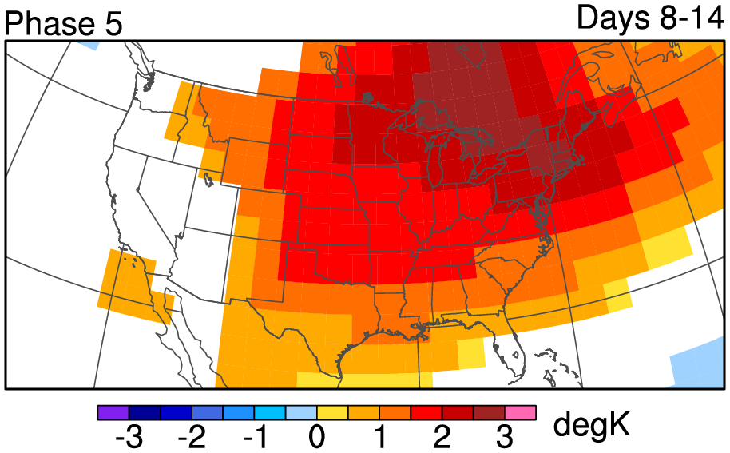
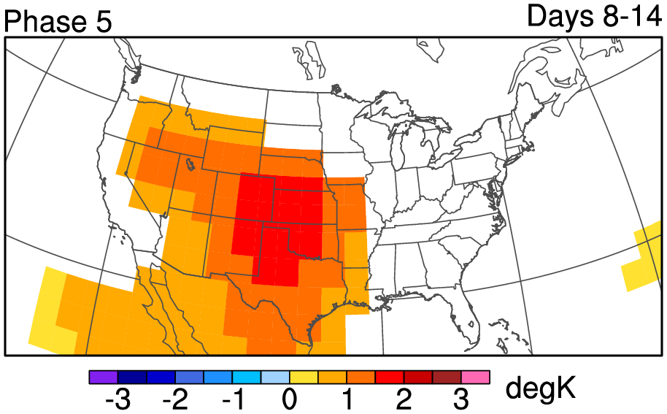
Week-2 based on RMM and MVP
March 2012
December 2000
“Forecasted”
MJO Background
MultiVariate PNA (MVP)
Tale of Two MJOs

Slide 26
Week-2 based on RMM and MVP
March 2012
December 2000
“Forecasted”
Observed
MJO Background
MultiVariate PNA (MVP)
Tale of Two MJOs

Slide 27
MJO Summary
Wheeler–Hendon RMM
  Easy way to track the MJO
  Dominated by winds
  (Over?)simplifies tropical variability
MultiVariate PNA (MVP) Index
  Combines tropics and extratropics by using OLR and streamfunction
  Stronger MWE temperature signals than conventional PNA
  Combining the MVP with the RMM provides even more value
MJO Background
MultiVariate PNA (MVP)
Tale of Two MJOs

Slide 28
The Road Forward
Combinations of the RMM and other indices
  Esp. AO/NAO
Regional MJO Indices
  Esp. Eastern Pacific
Other alternatives to RMM
  Fourier filtering for tropical waves
  Focus on convection or winds/velocity potential?
MJO Background
MultiVariate PNA (MVP)
Tale of Two MJOs

